Slide 1
The Invisible Infrastructure of Education
EDC&I 505 J
4 April 2012

Slide 2
Our Agenda Today
Suggestions for additional/different course topics? (Plus, any schedule changes?)
The “Invisible Infrastructure” of education and its relationship to ODL
Discuss Horton (& Brown et al.)
Useful resources and sites (a tour)
Your project/paper ideas and plans

Slide 3
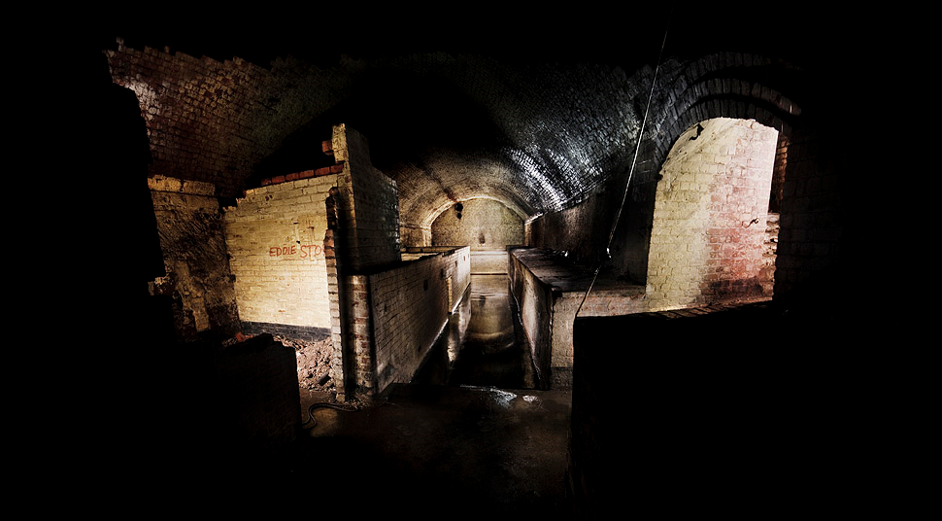
Invisible Infrastructure?
What’s that?

Slide 4
So What’s the Visible Infrastructure?
Buildings, classrooms, libraries, equipment
Textbooks, syllabi, quizzes/tests, videos, papers
Schedules (day/week/quarter), bells
Catalogs, programs, requirements

Slide 5
What’s Not on That List?
All the stuff that happens, but isn’t “officially” there; for example:
Student-instructor interaction
Student-student interaction
Extra-class sources of support
Extracurricular activities
Some examples:

Slide 6
Student-Instructor Interaction
Before class
“Can I just ask you one question about next week’s assignment?”
During class
“Could you explain in more detail that last example of the oxidation cycle of methane?”
After class
“Will next week’s quiz cover all the materials in the text on taxation of offshore corporations or just what was in the text?”
Outside of class
“Will you have regular office hours next week? Can I stop by?”
Outside the scope of the typical
“What should I do with my life?”

Slide 7
Student-Student Interaction
Before class
“What are you doing for next week’s assignment?”
During class
“Did you understand that last example of the oxidation cycle of methane?”
After class
“What do you think will be on next week’s quiz?”
Outside of class
“Can you figure out what this course is supposed to be about?”
Outside the scope of the typical
“If we go to the big student rally in Red Square, will we be marked down in that class?”

Slide 8
Extra-Class Sources of Support
Libraries (and librarians)
Labs (and lab assistants)
Student services and advising offices
Departmental staff
(i.e., the ones who really know how things work…)
Friends, study/support groups, former teachers

Slide 9
Extracurricular Activities
Peri-instructional groups
Student disciplinary societies,
Cultural activities (related to a course, or not)
E.g., plays, concerts, speakers, debates, films and videos
Hangouts
Cafeterias, coffee shops, lounges, bars

Slide 10
The Point?
A lot of learning (and support for learning) takes place outside of the formal structures of the ed system
Much of it is unplanned, some of it is idiosyncratic to person/place
Can we duplicate in online/distance settings?
If we can’t duplicate, exactly, what parts can we simulate? And should we try?

Slide 11
So, for Example…
Student-Instructor Interaction
Provide access to instructor in ways that match the online course (message boards, texting, toll-free phone, etc.)
Make it possible for students to communicate questions during an online class
Online office hours
Make sure students can get answers to multiple types of questions (from “How do I get this software to work?” to “What should I do with my life?”)

Slide 12
An Additional Thought
About online instructor-student and student-student interaction:
Maybe we shouldn’t always try to mimic in-class face-to-face interaction
OL interaction allows a more structured dialogue; the inveterate contributors can be checked, the silent or shy invited in
Instructors can sample more student ideas, address timing issues, control direction
Cf. Wertsch 2002 on Computer Mediation…

Slide 13
What Would Be OL Parallels for…?
Student-student interaction
Extra-class sources of support
Extracurricular activities
(Take a few minutes to think about these, then we’ll discuss)
Keep thinking about these as we move along!

Slide 14
Horton: Questions
How many checked out the book’s web site?
Instructional Design
Have you used this model? When/for what purposes?
Have you done “backwards design”? (Starting from desired end points, skills, etc.)

Slide 15
Backwards Design Cheat Sheet
Identify underlying goal (“What matters…”)
Defines end point of instruction and learning
Identify learners’ needs, abilities
Identify what to teach (“minimal manual” approach)
Analyze the gap between real (current) and ideal (desired) performance
In the skill taught, what does a proficient or expert person do differently, and how do you know?
Set objectives (only after doing all the above)
Determine criteria for success (assessment/types of performance, etc.)

Slide 16
An ID Exercise about ID Exercises
Given: A goal of this course is to enable you to think carefully and precisely about the design of OL courses and materials
Propose an exercise (activity; mini-design project) that would:
Require that you demonstrate actual ID skill
Determine that you had reached some defined/observable level of expertise
Involve you in some activity (-ies) that develop that expertise

Slide 17
For Next Week
Do the readings (Horton; Hsieh & Cho)
Look for current ODL tools (software, systems, etc.)
Select at least 2-3 for presentation and discussion in class
Be ready to say why the tool is interesting to you
If there are online examples that you can demo, post a link to the “General Discussion” website
Design how we’ll do the asynchronous session on 4/18

